Slide 1
CS248 Lecture 8
Simulation in Unity
February 1st, 2017

Slide 2
Some Logistics
Grade Emails
FAQ on Piazza
Partners?

Slide 3
Assignment 3 Overview
Particle Systems
Rigid Bodies

Slide 4
Assignment 3 Overview
Particle Systems
Rigid Bodies
Mostly coding (very quick though), unlike previous assignments

Slide 5

Particle Systems

Slide 6
Particle Systems (Summary)
Particle systems transform according to rules that you give it:
Initial velocity, velocity over time, size over time, etc.
You also control number of particles to spawn, when they spawn, when they stop spawning, etc.
Rendered using textures (each particle gets the same texture).
Can use a texture atlas to give particle system the illusion of changing over time (i.e. going from fire to smoke)
Free particle textures available on the asset store (you will probably find it hard to make your own)!

Slide 7
Common Example: Boids

Slide 8
Rigid Body Physics

Slide 9
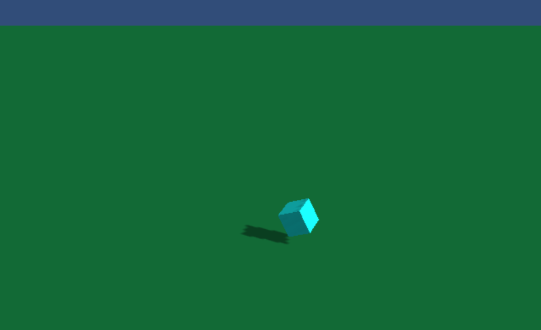
Rigid Body Physics
Guendelman et. al. 2003 - “Nonconvex Rigid Bodies with Stacking.”

Slide 10
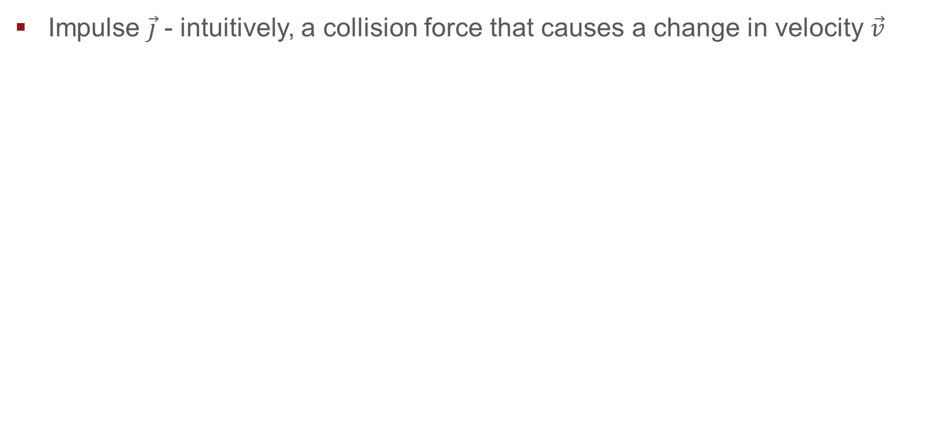
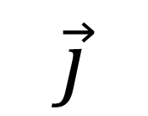
Rigid Body Physics
Impulse $\vec{j}$ - intuitively, a collision force that causes a change in velocity $\vec{v}$
$$\vec{j}$$

Slide 11
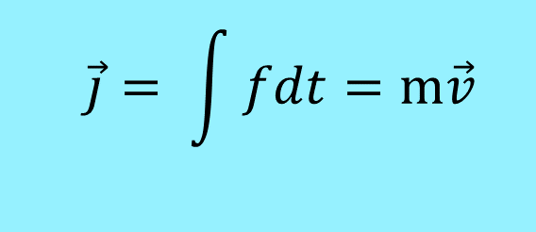
Rigid Body Physics
Impulse $\vec{j}$ - intuitively, a collision force that causes a change in velocity $\vec{v}$
$$\vec{j}= \int{fdt}=m\vec{v}$$
$$\vec{j}$$

Slide 12
Rigid Body Physics
Impulse $\vec{j}$ - intuitively, a collision force that causes a change in velocity $\vec{v}$
$$\vec{j}= \int{fdt}=m\vec{v}$$
Momentum
$$\vec{j}$$

Slide 13
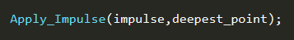
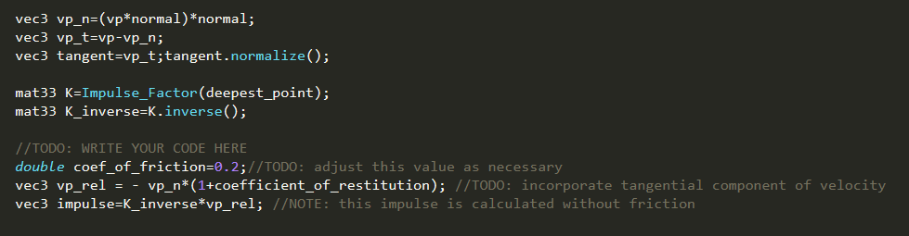
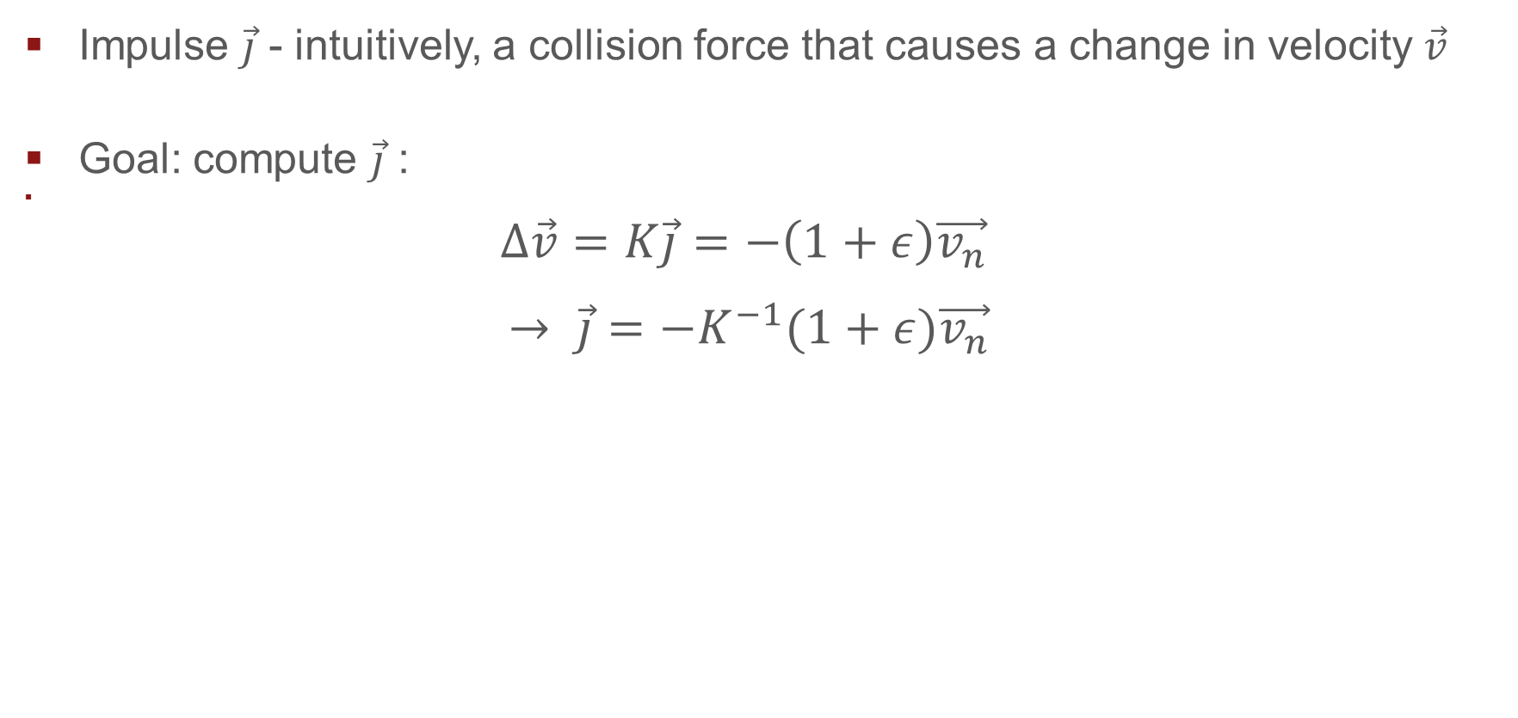
Rigid Body Physics
Impulse $\vec{j}$ - intuitively, a collision force that causes a change in velocity $\vec{v}$
Goal: compute $\vec{j}$ :
$$Δ\vec{v}=K\vec{j}=−\left(1+ε\right)\vec{v_{n}}$$ $$→ \vec{j}=−K^{−1}(1+ε)\vec{v_{n}}$$

Slide 14
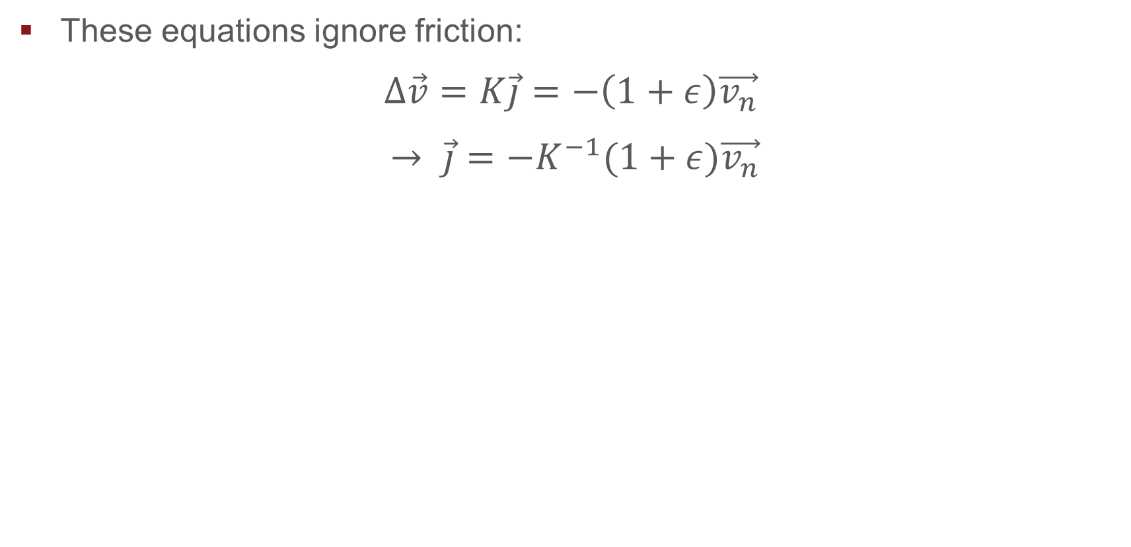
Rigid Body Physics – Missing Friction
These equations ignore friction:
$$Δ\vec{v}=K\vec{j}=−\left(1+ε\right)\vec{v_{n}}$$ $$→ \vec{j}=−K^{−1}(1+ε)\vec{v_{n}}$$

Slide 15
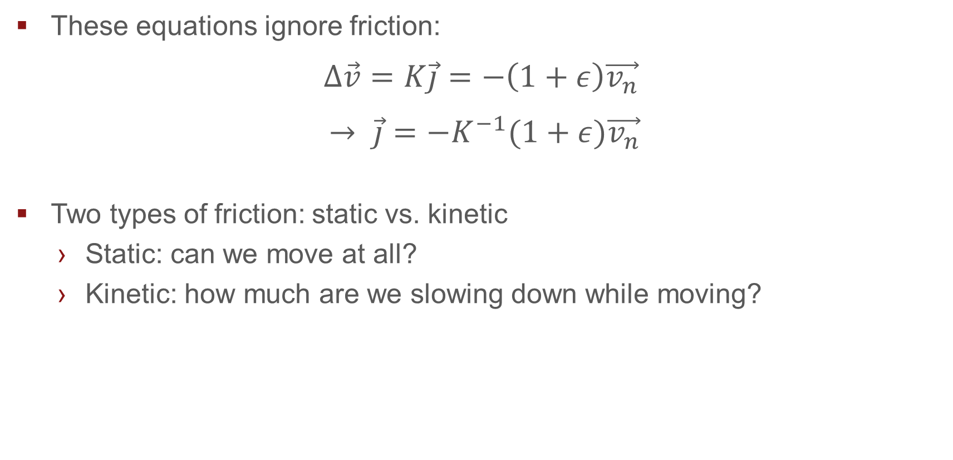
Rigid Body Physics – Missing Friction
These equations ignore friction:
$$Δ\vec{v}=K\vec{j}=−\left(1+ε\right)\vec{v_{n}}$$ $$→ \vec{j}=−K^{−1}(1+ε)\vec{v_{n}}$$
Two types of friction: static vs. kinetic
Static: can we move at all?
Kinetic: how much are we slowing down while moving?

Slide 16
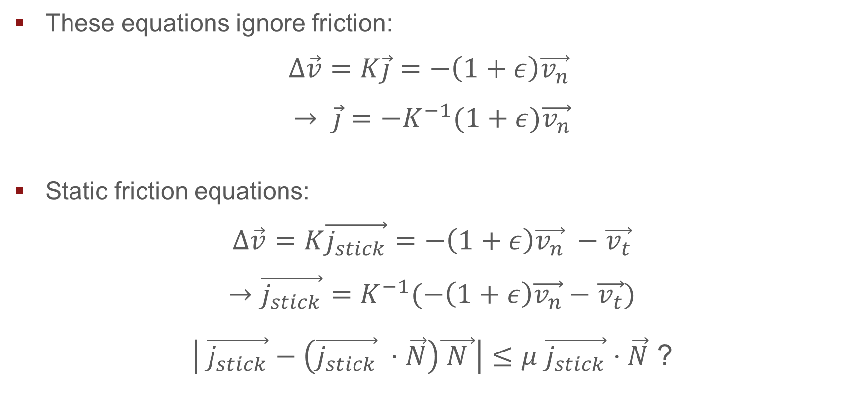
Rigid Body Physics – Missing Friction
These equations ignore friction:
$$Δ\vec{v}=K\vec{j}=−\left(1+ε\right)\vec{v_{n}}$$ $$→ \vec{j}=−K^{−1}(1+ε)\vec{v_{n}}$$
Static friction equations:
$$Δ\vec{v}=K\vec{j_{stick}}=−\left(1+ε\right)\vec{v_{n}} −\vec{v_{t}}$$
$$→\vec{j_{stick}}=K^{−1}(−\left(1+ε\right)\vec{v_{n}}−\vec{v_{t}})$$
$\left| \vec{j_{stick}}−\left(\vec{j_{stick}} ⋅\vec{N}\right)\vec{ N }\right|≤μ \vec{j_{stick}}⋅\vec{N}$ ?

Slide 17
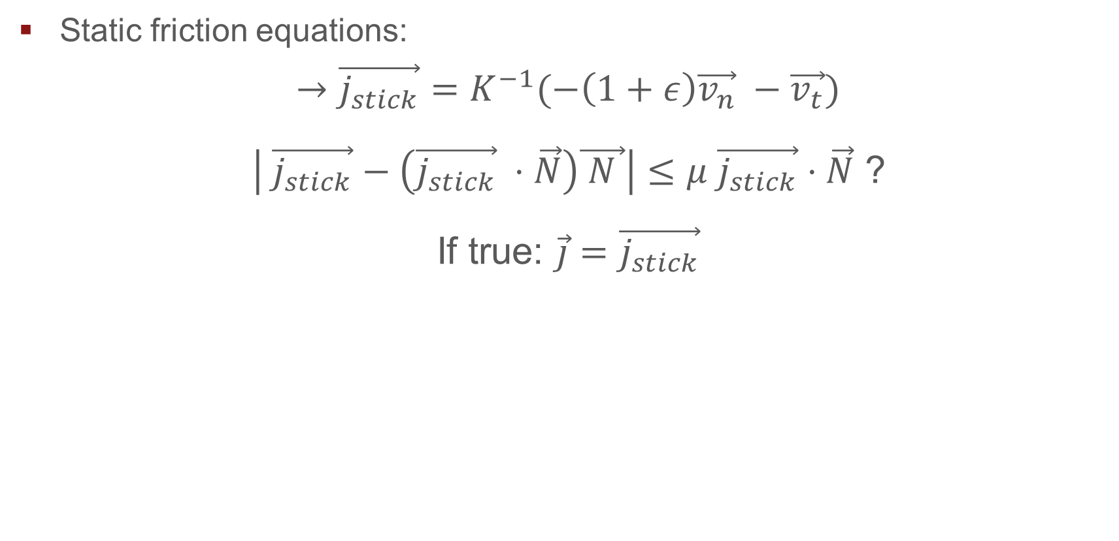
Rigid Body Physics – Missing Friction
Static friction equations:
$→\vec{j_{stick}}=K^{−1}(−\left(1+ε\right)\vec{v_{n}} −\vec{v_{t}})$
$\left| \vec{j_{stick}}−\left(\vec{j_{stick}} ⋅\vec{N}\right)\vec{ N }\right|≤μ \vec{j_{stick}}⋅\vec{N}$ ?
If true: $\vec{j}=\vec{j_{stick}}$

Slide 18
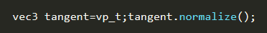
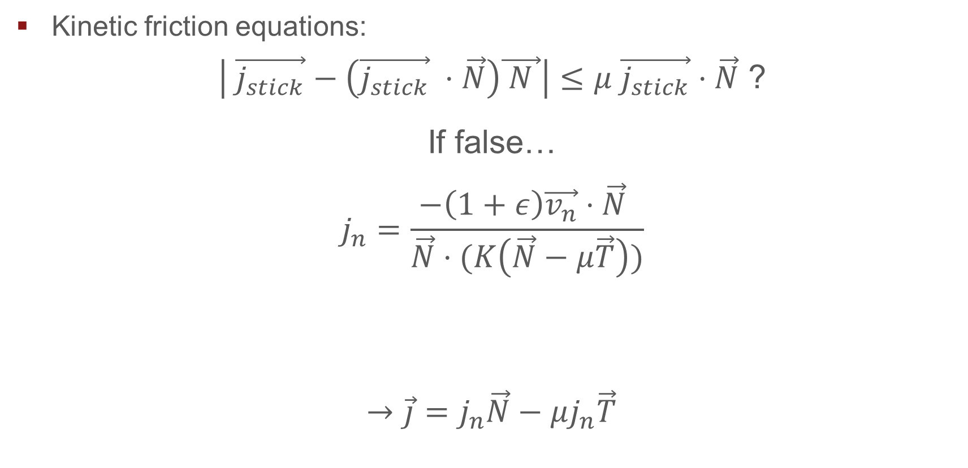
Rigid Body Physics – Missing Friction
Kinetic friction equations:
$\left| \vec{j_{stick}}−\left(\vec{j_{stick}} ⋅\vec{N}\right)\vec{ N }\right|≤μ \vec{j_{stick}}⋅\vec{N}$ ?
If false…
$$j_{n}=\frac{−\left(1+ε\right)\vec{v_{n}}⋅\vec{N} }{\vec{N}⋅(K\left(\vec{N}−μ\vec{T}\right))}$$
$→\vec{j}=$ $j_{n}\vec{N}−μj_{n}\vec{T}$

Slide 19
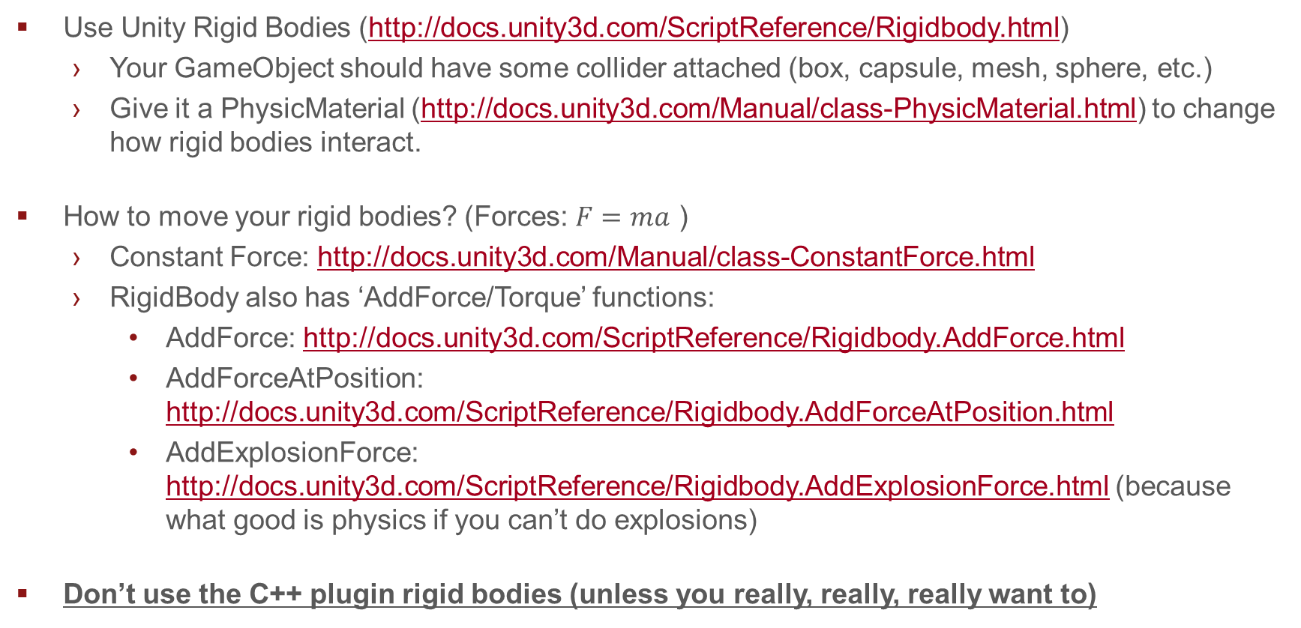
Rigid Body - Resources
Use Unity Rigid Bodies (http://docs.unity3d.com/ScriptReference/Rigidbody.html)
Your GameObject should have some collider attached (box, capsule, mesh, sphere, etc.)
Give it a PhysicMaterial (http://docs.unity3d.com/Manual/class-PhysicMaterial.html) to change how rigid bodies interact.
How to move your rigid bodies? (Forces: $F=ma$ )
Constant Force: http://docs.unity3d.com/Manual/class-ConstantForce.html
RigidBody also has ‘AddForce/Torque’ functions:
AddForce: http://docs.unity3d.com/ScriptReference/Rigidbody.AddForce.html
AddForceAtPosition: http://docs.unity3d.com/ScriptReference/Rigidbody.AddForceAtPosition.html
AddExplosionForce: http://docs.unity3d.com/ScriptReference/Rigidbody.AddExplosionForce.html (because what good is physics if you can’t do explosions)
Don’t use the C++ plugin rigid bodies (unless you really, really, really want to)

Slide 20
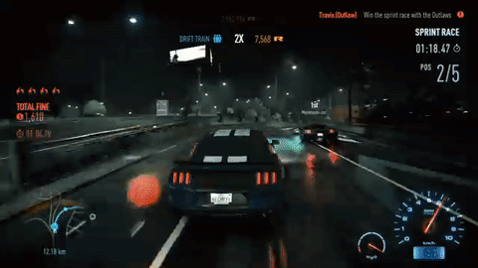
Wheels
Use wheel collider: http://docs.unity3d.com/Manual/class-WheelCollider.html
You can now move your vehicle by applying forces (or braking) to your wheels
Need For Speed 2015 Racing

Slide 21
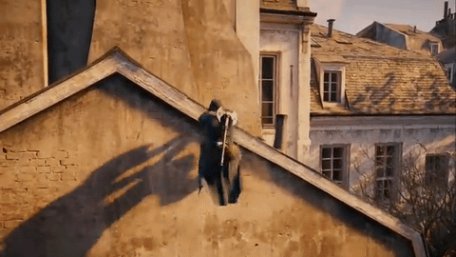
Cloth
Use Unity’s provided cloth component: http://docs.unity3d.com/Manual/class-Cloth.html
Your cloth won’t be perfect – it will intersect with things in the world and that’s okay.
Assassin’s Creed Unity Cloth

Slide 22
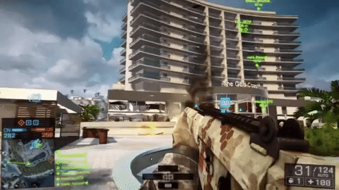
Fracture
Unity does not come with a built-in fracture system (UE4 does). Plugins exist (mainly non-free)
But the concept is fairly simple (implementation not so much):
Start off with a static mesh (i.e. a pillar).
Upon hitting the mesh with a force (i.e. with a ball), split the entire mesh (or just part of the mesh) using an algorithm (pre-generated or on the spot)
“Real Time Dynamic Fracture with Volumetric Approximate Convex Decompositions” - http://matthias-mueller-fischer.ch/publications/fractureSG2013.pdf
Apply forces to the fractured mesh pieces as necessary (i.e using the rigid body techniques from earlier)
Battlefield 4 Levolution

